Slide 1
A. Pukhov
Institute for Theoretical Physics I
University of Dusseldorf, Germany
Proton Driven
Plasma Wake Field Acceleration
AAC, Austin TX, 11 June 2012

Slide 2
PDPWA collaboration
1 Brookhaven National Laboratory, Brookhaven, USA
2 Budker Institute of Nuclear Physics, Novosibirk, Russia
3 CERN, Geneva, Switzerland
4 Cockroft Institute, Daresbury, UK
5 DESY, Hamburg, Germany
6 Universit¨at Heidelberg, Heidelberg, Germany
7 Heinrich Heine University, Dusseldorf, Germany
8 Instituto de Plasmas e Fusao Nuclear, IST, Lisboa, Portugal
9 Imperial College, London, UK
10 John Adams Institute for Accelerator Science, Oxford, UK
11 Karlsruher Institute of Technology KIT, Karlsruhe, Germany
12 LAL, Univ Paris-Sud, CNRS/IN2P3, Orsay, France
13 LOA, Laboratoire dOptique Applique, CNRS/ENSTA/X, France
14 Los Alamos National Laboratory, NM, USA
15 Ludwig Maximilian University, Munich, Germany
16 Max Planck Institute for Physics, Munich, Germany
17 Max Planck Institute for Plasma Physics, Greifswald, Germany
18 Panjab University, Chandigarh, India
19 Rutherford Appleton Laboratory, Chilton, UK
20 State Key Laboratory of Nuclear Physics and Technology, Peking University, China
21 Tsinghua University, Beijing, China
22 University of California, Los Angeles, CA, USA
23 University College London, London, UK
24 University of Oslo, Oslo, Norway
25 University of Strathclyde, Glasgow, Scotland, UK

Slide 3
Outline
Why protons as the driver?
Proton bunch self-modulation in plasma
Phase velocity of the wake
Electron injection
Towards TeV energies

Slide 4
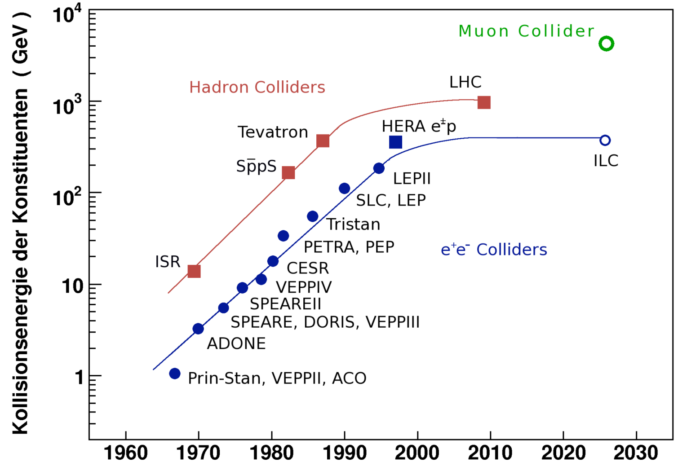
Livingston plot shows saturation
New technology is required!

Slide 5
Why a linear collider or muon collider?
Leptons preferred: collide point-like particles rather than complex objects
But, particles radiate when accelerated, power as
Need linear accelerator or heavy particles (large m)!

Slide 7
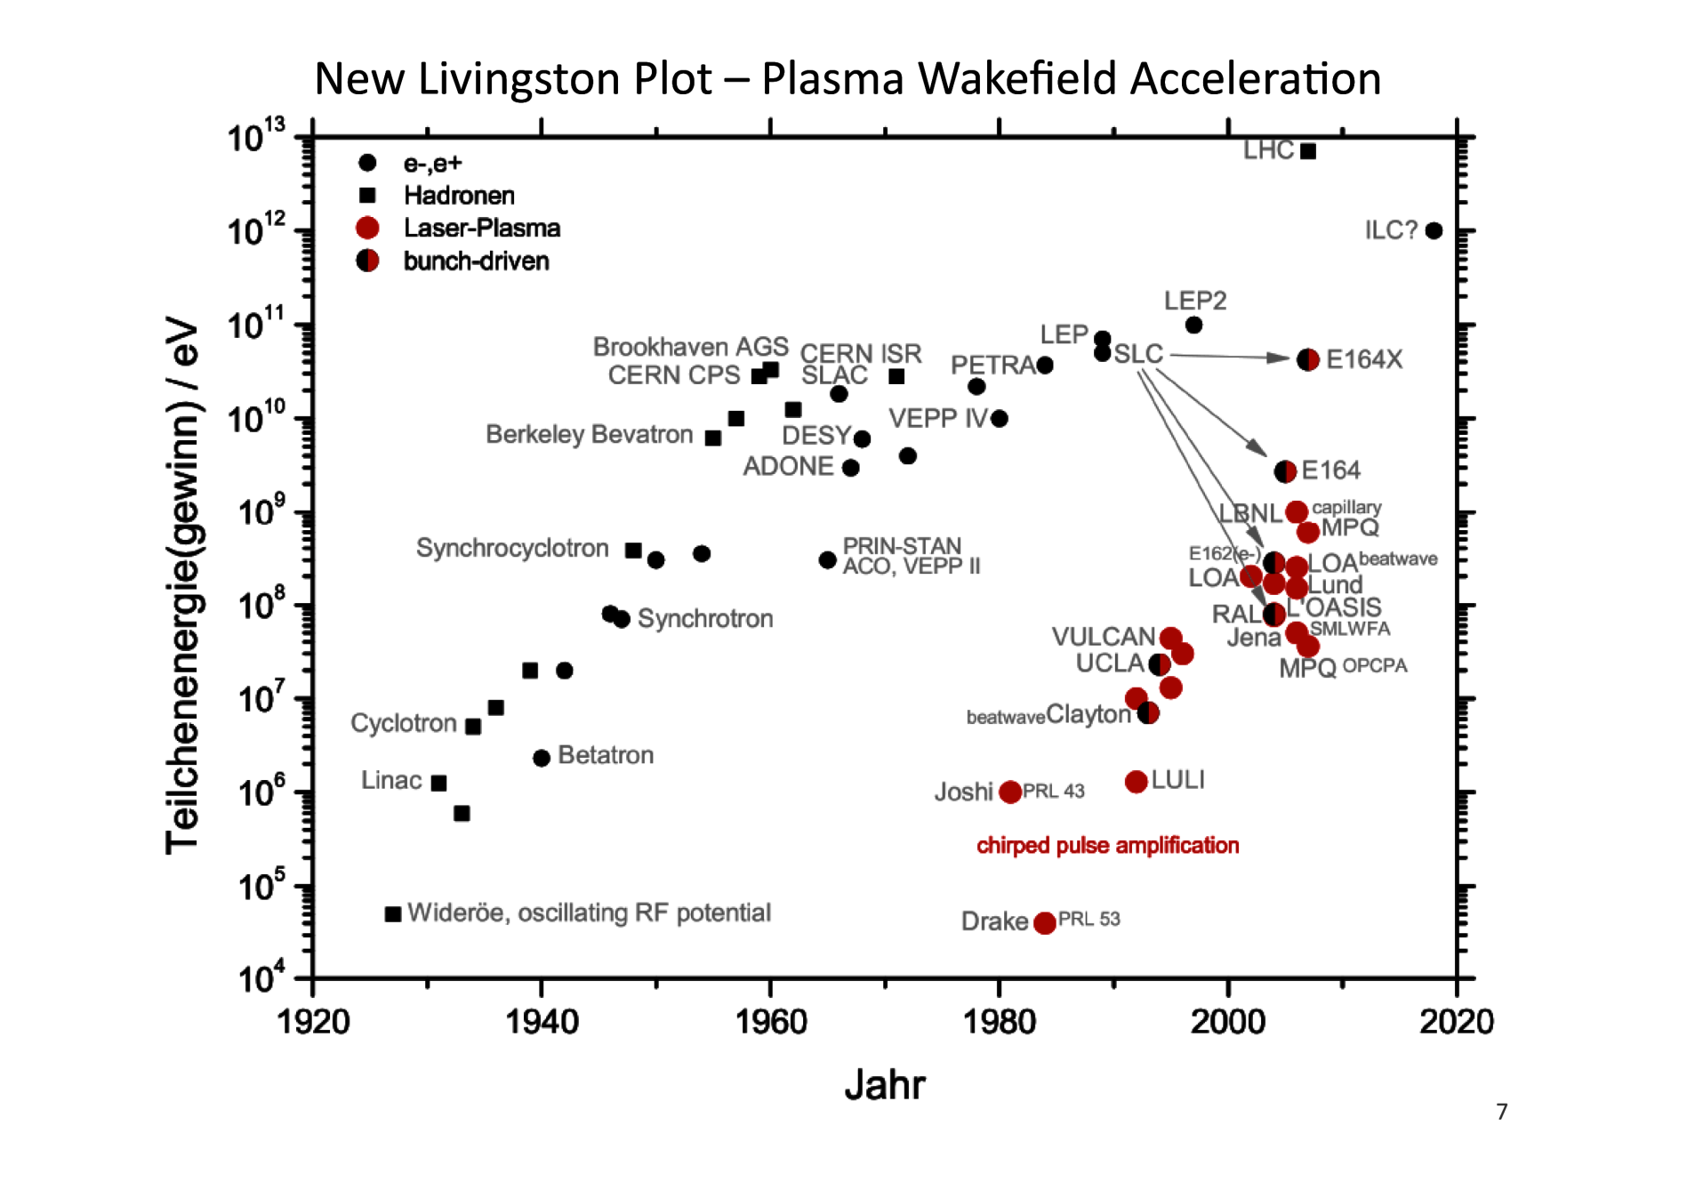
New Livingston plot: plasma acceleration

Slide 8
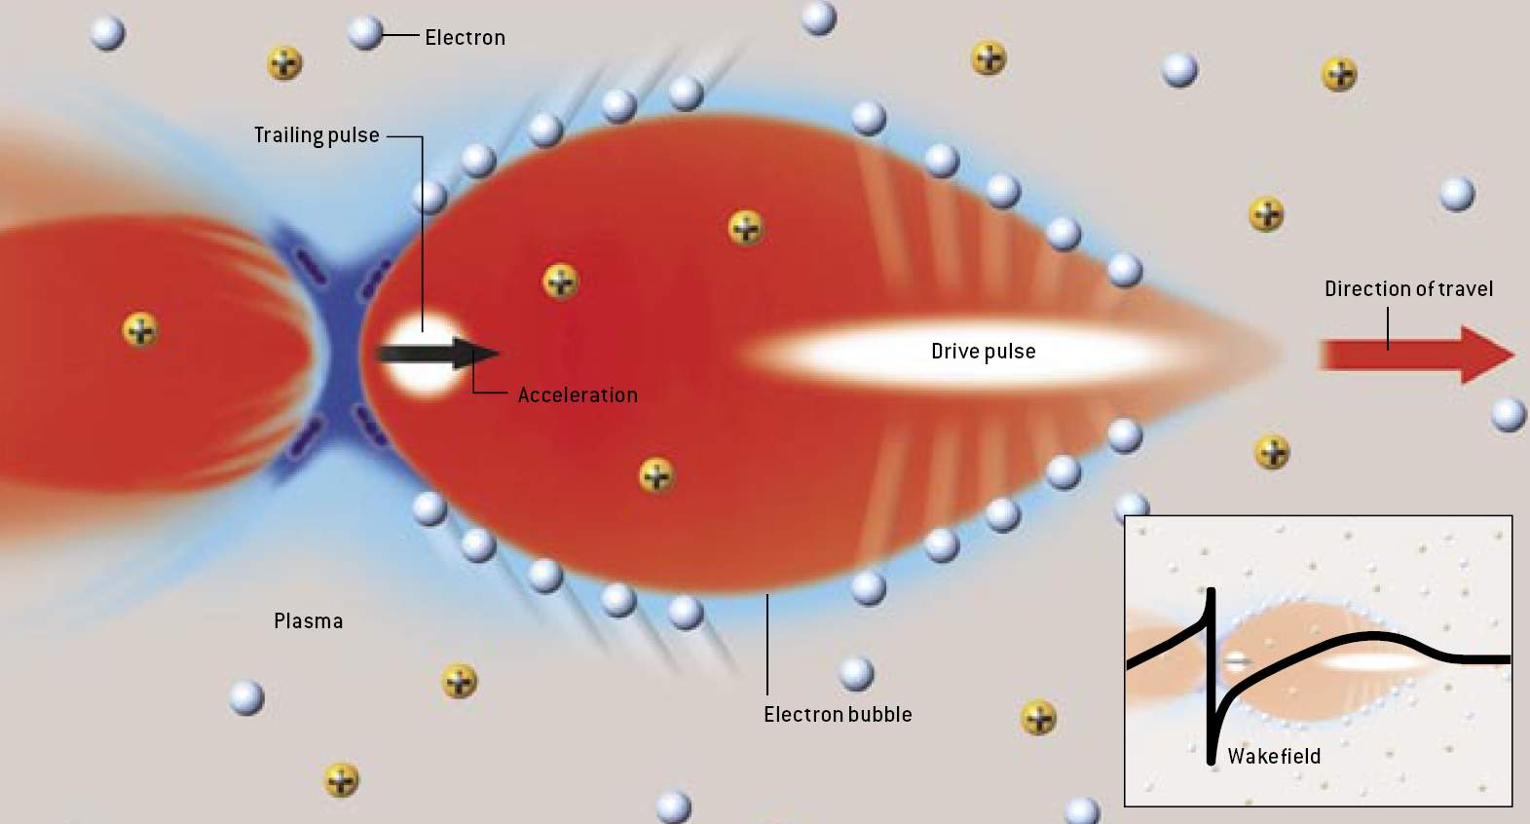
Nonlinear “blowout” regime
Electron beam driven wake field in the blowout regime
Ch. Joshi, UCLA

Slide 9
Transformer ratio
Why not continue with electrons???
There is a fundamental limit on energy gain (symmetric driver):
This means that many stages are required to reach TeV from known e-beams (SLAC has 45 GeV)
TeV proton bunches exist today. So, why not use them?

Slide 10
Proton driven wake fields
Both laser-driven and electron-driven acceleration will require many stages to reach TeV energies
We know how to produce multi-TeV proton bunches with >10¹¹ population today. We can use these bunches to accelerate electrons to TeV possibly in single stage.
Need short proton bunches for high gradient acceleration.
Today’s proton bunches σ_{z}=10…30 cm

Slide 11
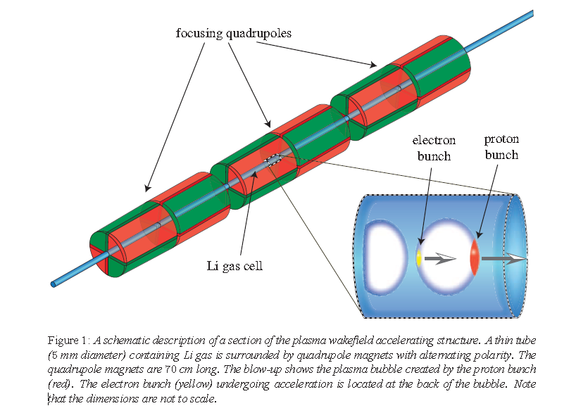
Possible accelerator
Caldwell, Lotov, Pukhov, Simon, Nature Phys. 5, 363 (2009)

Slide 12
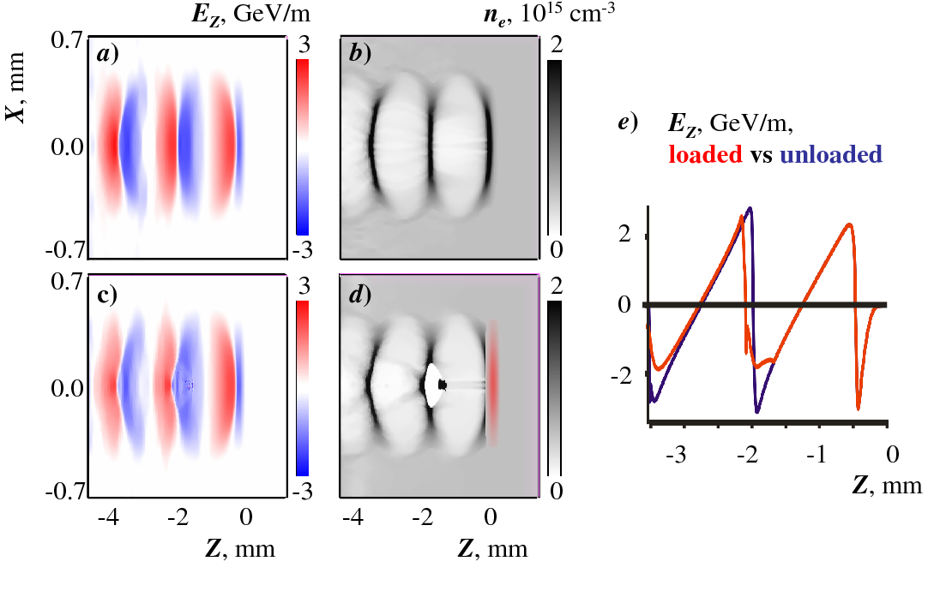
Short proton driver, τω_{p}~1: Excellent wakefield generation
Caldwell, Lotov, Pukhov, Simon, Nature Phys. 5, 363 (2009)

Slide 13
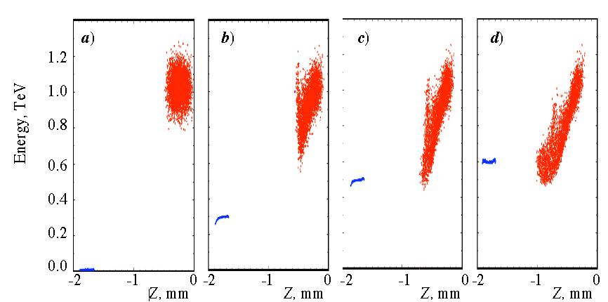
Phase space evolution
Caldwell, Lotov, Pukhov, Simon, Nature Phys. 5, 363 (2009)
Initial 150 m 300 m 450 m

Slide 14
Problem: proton beams are too long
100 μm short proton beam assumed
Realistic beams are ~10 cm long
Solution: self-modulated regime

Slide 15
Self-modulation instability
Pukhov et al. Phys. Rev. Lett. 107, 145003 (2011)
Kumar, Pukhov, Lotov, Phys. Rev. Lett. 104, 255003 (2010)
Equation for the beam envelope radius r_{b}
Positive feedback
is the beam plasma frequency
is defined by beam emittance

Slide 16
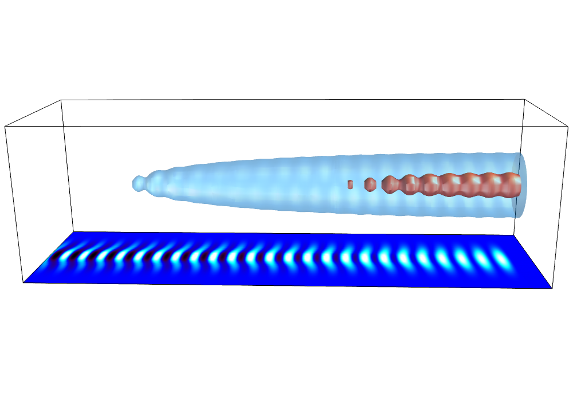
Proton beam self-modulation in plasmas
Beam self-modulates at plasma wavelength…
…and excites resonant wake field

Slide 17
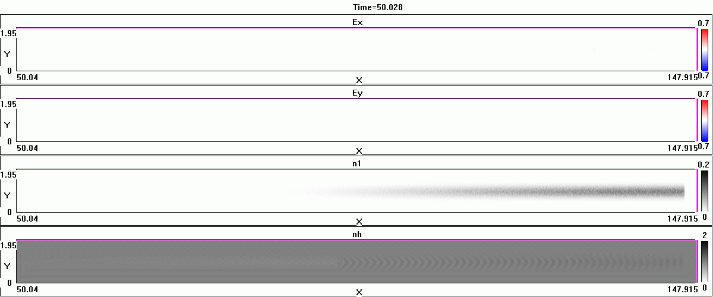
Beam self-modulation 3D PIC results

Slide 18
Numerical challenges
The code must simulate 1000 plasma oscillations
Be efficient to simulate many 10 meters of plasma
Disparate scales:
Plasma skin length 200 μm
Beam length 240 mm
Propagation length 10…100 m

Slide 19
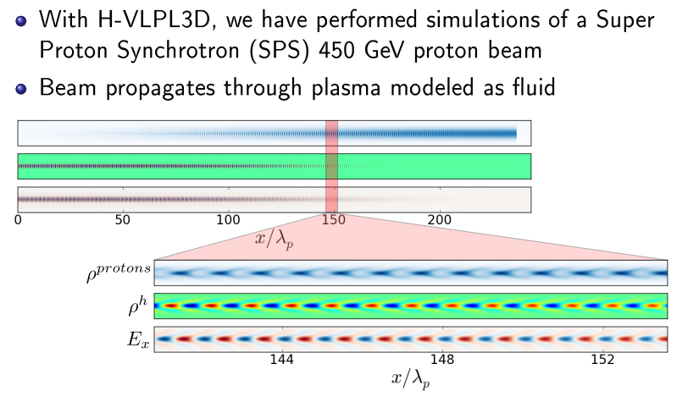
SPS bunch simulations
T. Tuckmantel, A. Pukhov, J. Liljo, M. Hochbruck, IEEE TPS, 38, 2383-2389 (2010)

Slide 20
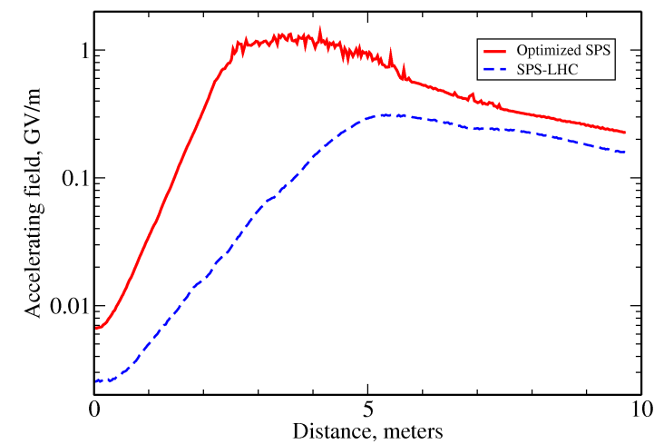
Expected accelerating field

Slide 21
Electron injection into wake
What should be the initial energy of electrons?
The driver has a γ-factor of a few 1000.
Do we need a GeV electron injector?
Can we trap a few MeV electrons?

Slide 22
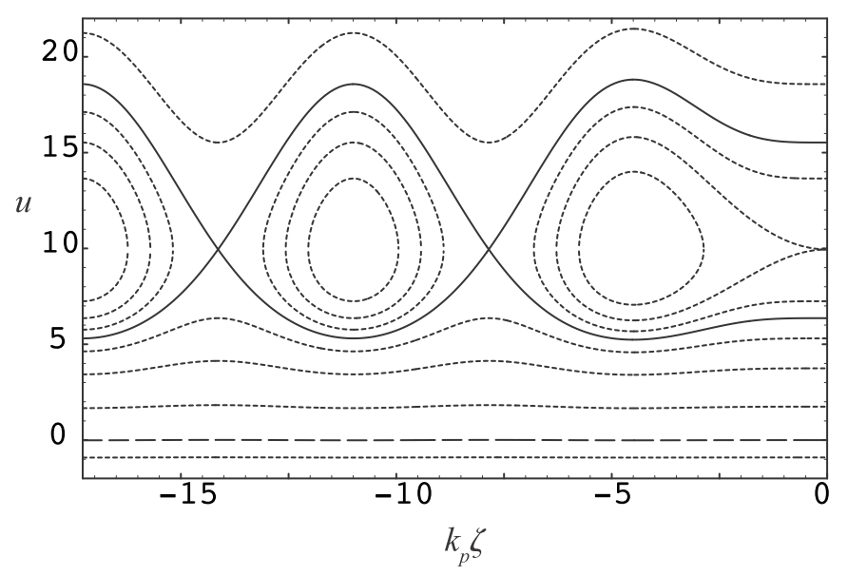
Electron phase space
Esarey et al., 2009

Slide 23
Energy gain
The wake phase velocity defines the maximum possible energy gain
For a large amplitude wake, , the energy gain is
Taking sustained E_{max}=0.1 produced by SPS-LHC, we need γ_{ph}> 70 to reach 1 GeV energy gain.

Slide 24
Analytical theory
Pukhov et al., Phys Rev Lett (2011), C. Schroeder et al., Phys Rev Lett (2011)
The dispersion relation has three solutions.
One fast, stable mode:
And two slow modes, one decaying, one growing:
The phase velocity of the growing mode is

Slide 25
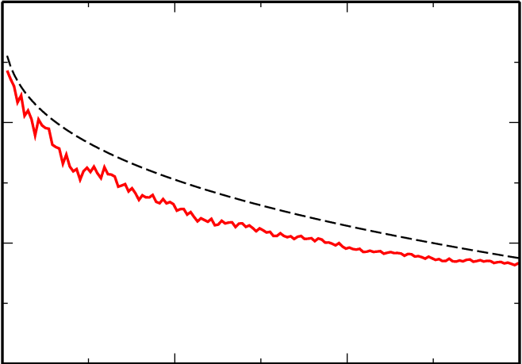
Comparison theory vs simulation
Pukhov et al., Phys Rev Lett (2011)
x 10⁻⁴
0
(c)
(v_{ph} – c )/ c
-1
-2
0
50
100
ξ/2π

Slide 26
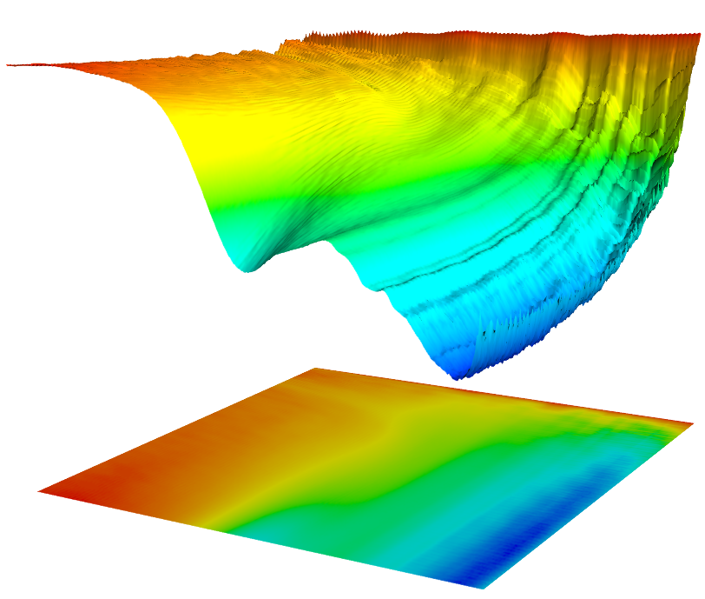
Phase velocity of the wake
Pukhov et al., Phys Rev Lett (2011)
The wake is slowed down. Its minimum gamma-factor is
γ_{min}~ 40 This is order of magnitude below that of the beam
(v_{ph} – c )/ c, x10⁻⁴
(b)
0
-1
-2
-3
-4
0
10
100
5
200
ξ/2π
Z, m
0

Slide 27
Electron injection
Side injection after 6 meters, at 0.005 rad angle, 8 MeV electrons

Slide 28
Electron injection
Side injection after 6 meters, at 0.005 rad angle, 8 MeV electrons

Slide 29
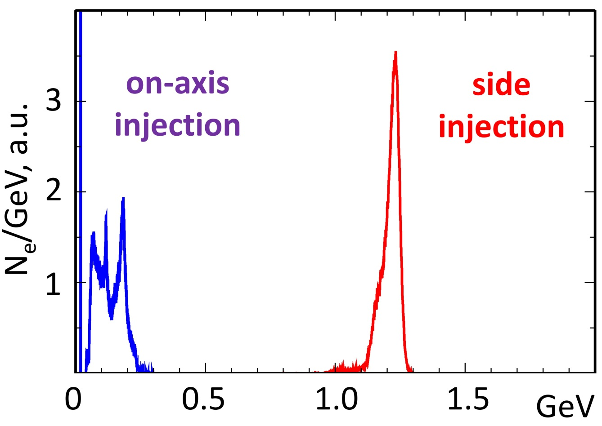
Electron injection
Side injection after 6 meters, at 0.005 rad angle,
8 MeV electrons

Slide 30
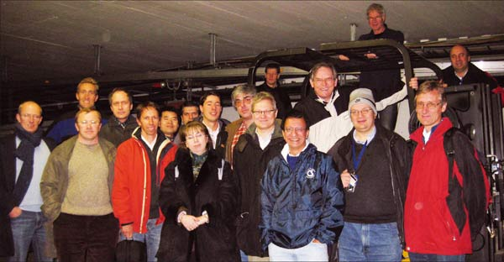
PDPWA at CERN
European Network on Novel Accelerators , lead by CERN
First proton-driven plasma wake field acceleration workshop held at LHC
Dec. 2009
Pilot experiment:
Demostrate 1 GeV gain in 10 meters using SPS driver

Slide 31
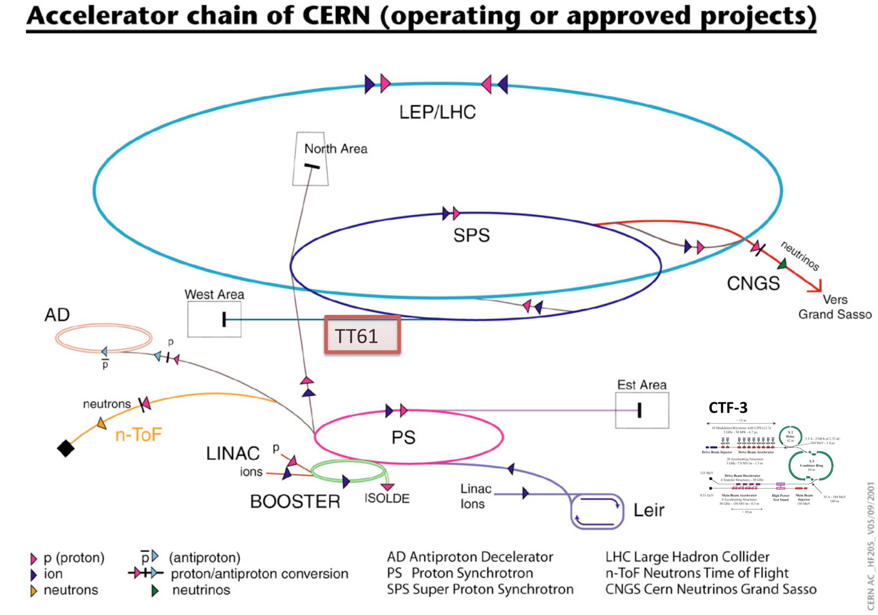
Expected accelerating field

Slide 33
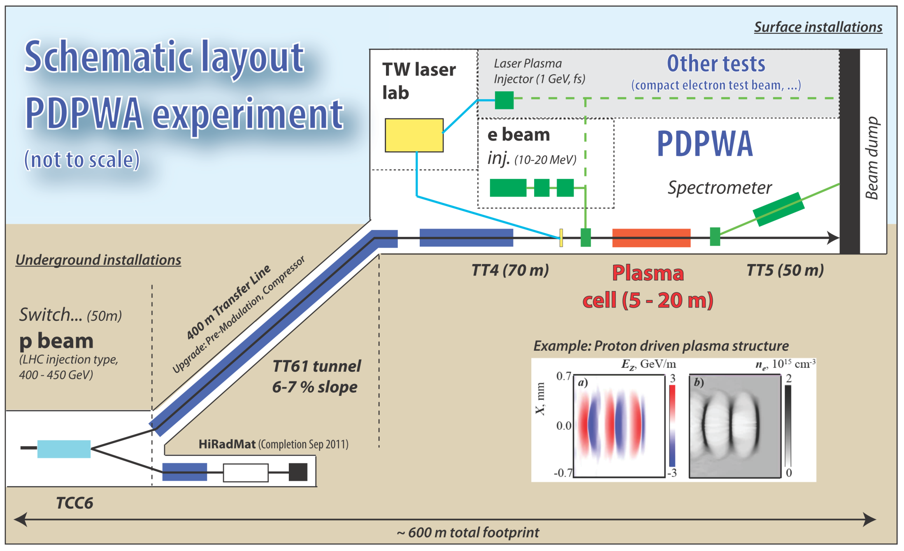

Slide 34
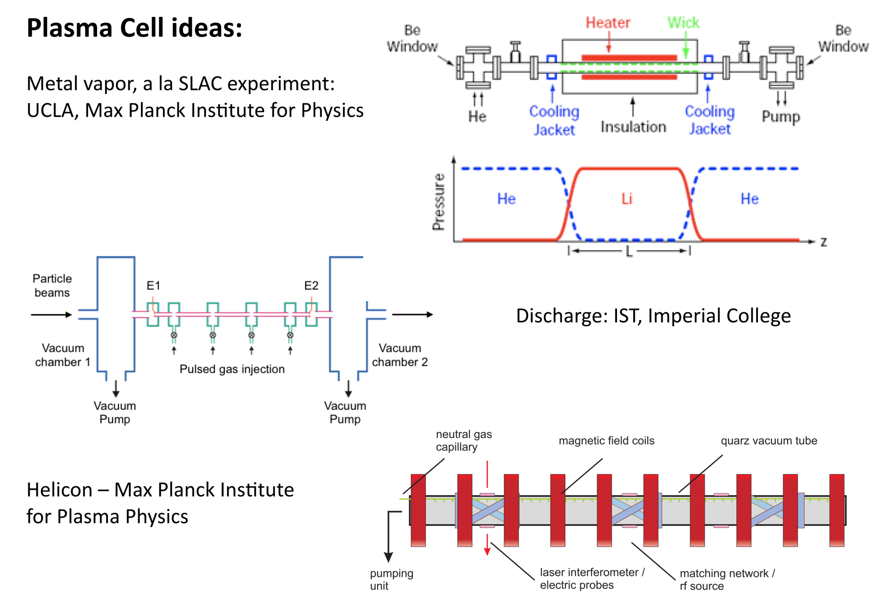

Slide 35
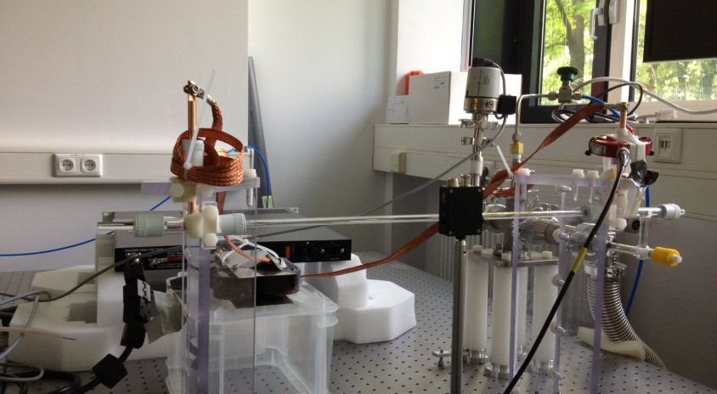
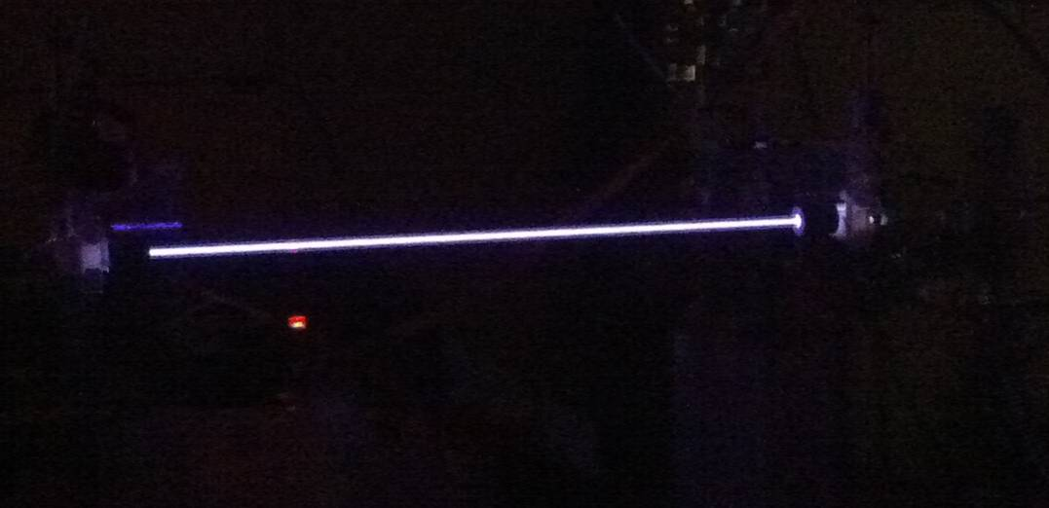
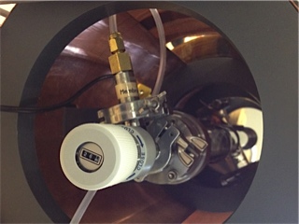
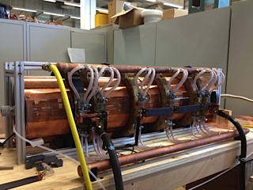
Discharge plasma source at MPP, Munich
Helicon plasma source at IPP, Greifswald

Slide 36
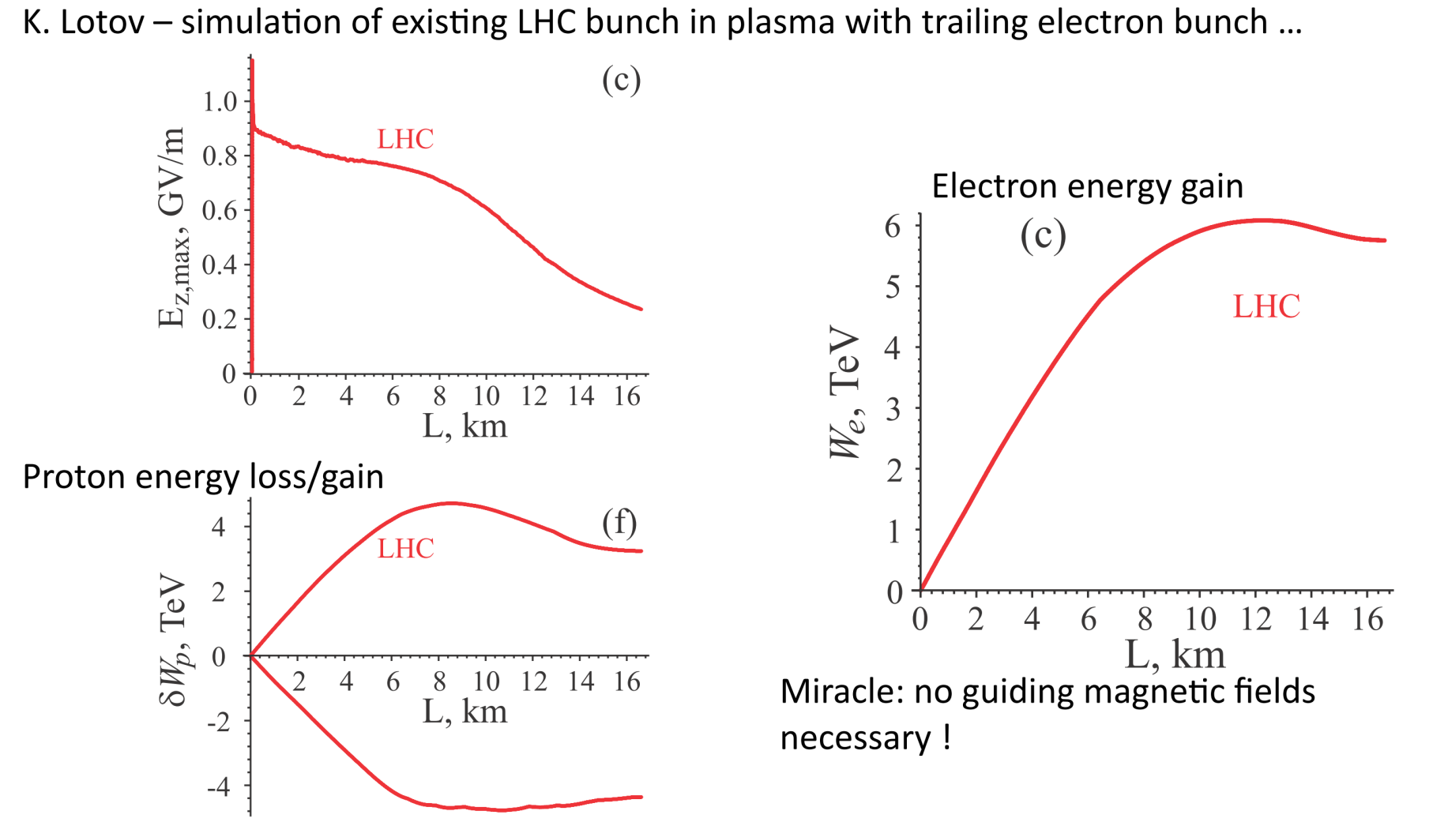
Outlook
Caldwell, Lotov, Phys. Plasmas 18, 13101 (2011)

Slide 37
